Slide 1
Data Analysis
Review

Slide 2
Linear Algebra

Slide 3
آنالیز داده

Slide 4
Machine learning and AI

Slide 5
Data Preparing

Slide 6
Challenges in data collection
Data Collection
Data Quality
accurate and relevant
missing values
Outliers
incorrect data
Data Labeling:
data needs to be correctly labeled
Data Imbalance:
some classes are overrepresented while others are underrepresented
Feature Engineering:
Identifying and engineering the right features from the data
Data Privacy and Ethics
Ensuring that the data does not violate privacy rights or ethical norms is crucial, especially when dealing with sensitive information like personal data.
Data Scaling and Transformation:
Normalization
Scaling
Transformation
Handling High-Dimensional Data
Data Integration:
Combining data from different sources (varying formats, scales, or schemas)
Data Storage and Management
Time-Series Data Specific Challenges:
handling temporal dependencies, seasonality, and time-based splits for training and testing arise.

Slide 7
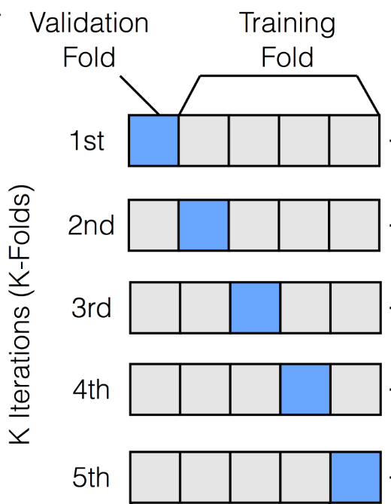
K Fold
K-Fold Cross-Validation
the entire dataset is divided into 'K' equal-sized folds or subsets

Slide 8
Cross-Validation Process:
Each iteration:
1 of K folds → validation set
K-1 folds are combined to form the training set.
This process is repeated K times, each time with a different fold serving as the validation set.

Slide 9
Performance Measurement
These scores are typically averaged to obtain a more comprehensive measure of model performance.

Slide 10
Advantages
Reduced Bias
By rotating the validation set across all parts of the dataset, it minimizes the bias associated with random sampling.
Efficient Use of Data
Especially useful in scenarios where the amount of available data is limited. It ensures that every data point is used for both training and validation.
Model Robustness
Helps in assessing the model's robustness and its ability to generalize to new, unseen data.

Slide 11
Disadvantages
Computationally Intensive
Not Suitable for Time-Series Data

Slide 12
Variations
Stratified K-Fold
Ensures that each fold is a good representative of the whole by having approximately the same percentage of samples of each target class as the complete set.
Time Series Cross-Validation
A variation designed for time-series data, ensuring that the validation set always comes after the training set in time.

Slide 13
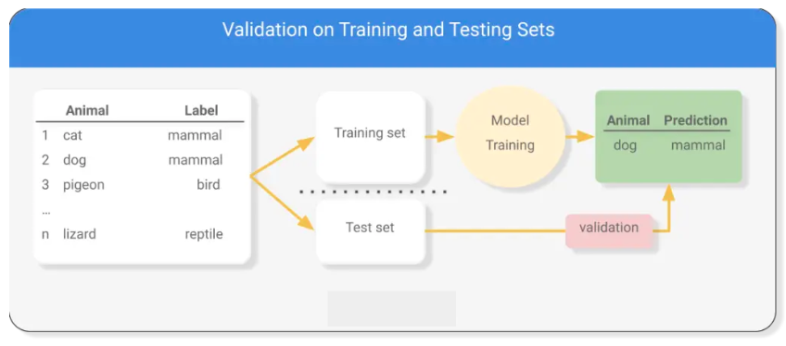
Data Separation
Training Set
Testing Set
Validation Set
How well the model generalizes to new, unseen data

Slide 14
Train_test_split: randomly splits the data.
test_size=0.2: means that 20% of the data will be used for testing.
random_state: reproducibility of the results.

Slide 15
Classification classes
Binary Classification
Multiclass (or Multinomial) Classification
Multilabel Classification
Multiclass-Multilabel Classification
Hierarchical Classification
Imbalanced Classification

Slide 16
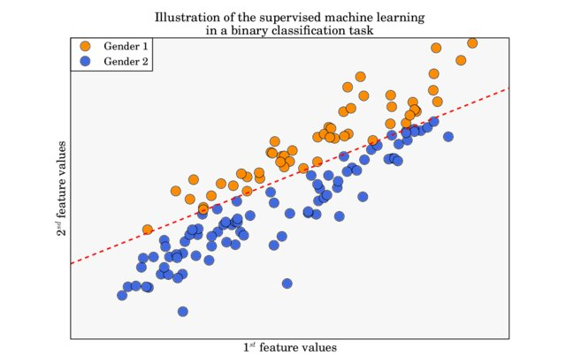
Binary Classification
"spam" or "not spam"

Slide 17
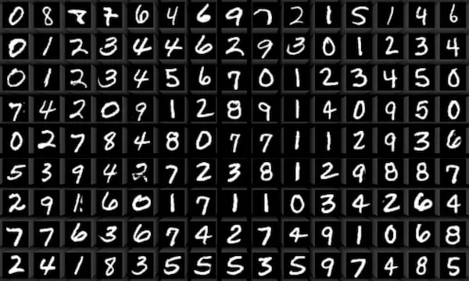
Multiclass (or Multinomial) Classification

Slide 18
Multilabel Classification
In multilabel classification, each instance can be assigned multiple labels simultaneously. This is different from multiclass classification, where each instance is assigned to only one class.
A movie can be categorized into multiple genres simultaneously, such as Action, Comedy, and Drama

Slide 19
Multiclass-Multilabel Classification
In a medical diagnosis application, a patient’s case could be diagnosed with multiple diseases (labels), and each disease is part of a larger set of possible diseases (classes).

Slide 20
Hierarchical Classification
Organizing animals into a hierarchy where at the top level you classify an animal as a mammal, bird, reptile, etc., and at lower levels, further classify mammals into cats, dogs, etc.

Slide 21
Imbalanced Classification
In fraud detection, legitimate transactions vastly outnumber fraudulent ones, leading to an imbalanced dataset

Slide 22
classification metrics

Slide 23
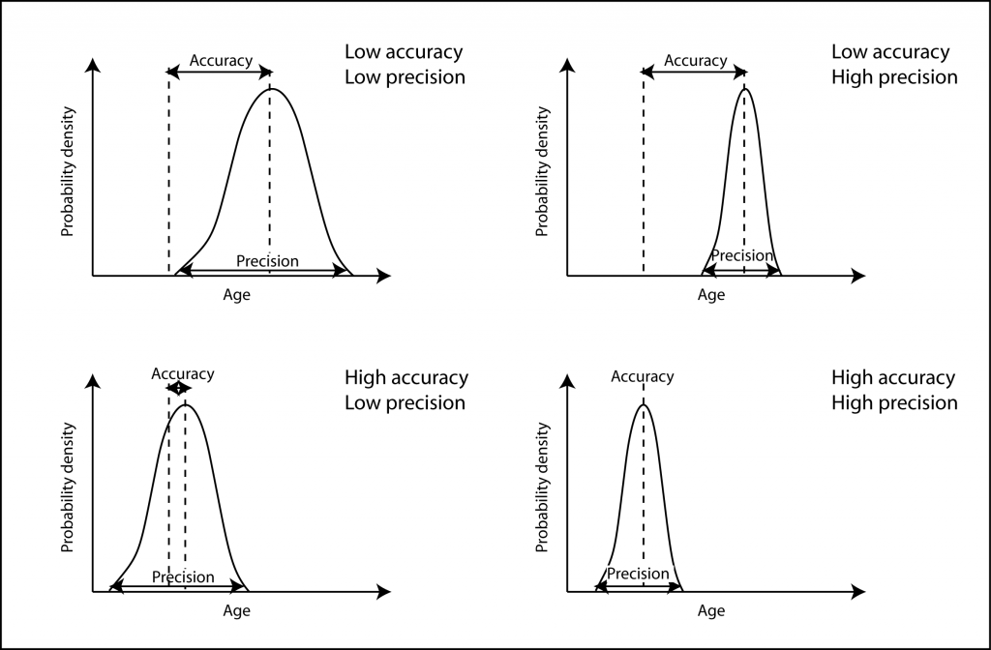

Slide 24

Accuracy
Best used when the classes are balanced and false positives/negatives have similar consequences

Slide 25
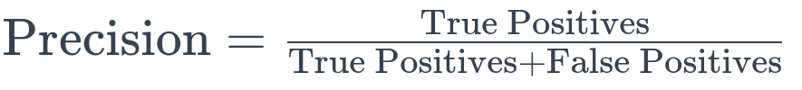
Precision
Important when the cost of false positives is high (e.g., in spam detection, where it’s worse to mislabel non-spam as spam)

Slide 26
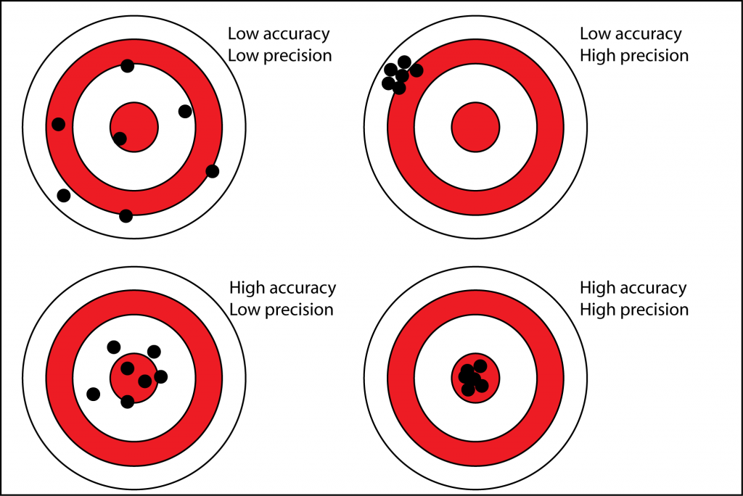

Slide 27
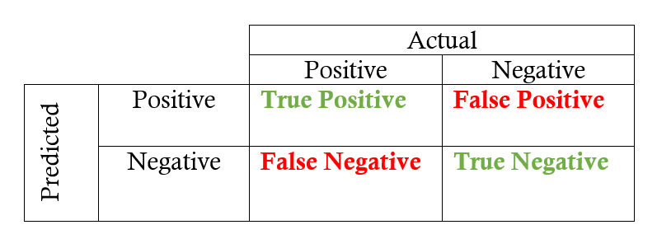

Slide 28
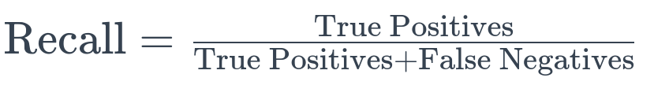
Recall (Sensitivity)
Crucial when the cost of false negatives is high (e.g., in medical diagnostics)

Slide 29

F1 Score
The F1 Score is the weighted average of Precision and Recall. It balances both metrics.

Slide 30
Confusion Matrix
A table showing the performance of a classification model. Each row represents the instances in an actual class, while each column represents the instances in a predicted class.
Provides a detailed breakdown of correct and incorrect classifications for each class

Slide 31
ROC Curve and AUC
ROC Curve: Graphical representation of the true positive rate (Recall) against the false positive rate for various threshold settings.
AUC (Area Under the ROC Curve): Measures the entire two-dimensional area underneath the ROC curve. A higher AUC indicates a better performing model.
Use Case: Useful in binary classification for evaluating the trade-off between true positive rate and false positive rate. Particularly good for imbalanced datasets.

Slide 32
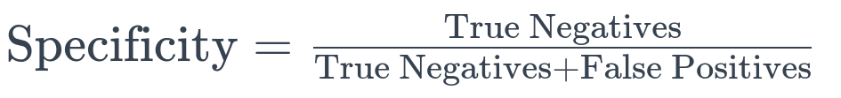
Specificity
The ratio of correctly predicted negative observations to the total actual negatives.
Important when the ability to correctly identify negatives is crucial.

Slide 33
Log-Loss (Cross-Entropy Loss)
Measures the performance of a classification model where the prediction is a probability value between 0 and 1.

Slide 34
Consideration
primarily False Positives (FP) and False Negatives (FN)

Slide 35
Medical Diagnosis
False Negatives: Missing a diagnosis (e.g., failing to detect cancer when it is present). This is a serious error as it can lead to delayed treatment and worsen the patient's condition.
False Positives: Incorrectly diagnosing a disease (e.g., diagnosing cancer when it is not present). This can cause unnecessary stress for the patient and may lead to unnecessary treatments, which could have side effects.

Slide 36
Spam Email Filtering
False Positives: Classifying a legitimate email as spam. This can be inconvenient for users as they might miss important emails.
False Negatives: Failing to identify a spam email. This is less critical than a false positive, as it may only result in minor annoyance to the user.

Slide 37
Fraud Detection in Banking
False Positives: Flagging a legitimate transaction as fraudulent. This can frustrate customers and potentially lead to loss of business if it happens frequently.
False Negatives: Missing a fraudulent transaction. This can have significant financial implications and can also damage the reputation of the financial institution.

Slide 38
One-Hot Encoding

Slide 39
Why Use One-Hot Encoding?
Machine Learning Models
Dummy Variables
Removing Bias

Slide 40
Key Features of KNNImputer
Nearest Neighbors Imputation:
The KNNImputer replaces missing values using the k-Nearest Neighbors approach. Each missing value is imputed using the mean value from 'n_neighbors' nearest neighbors found in the training set. By default, n_neighbors=5.
Distance Metric:
The distance between samples to find the nearest neighbors is calculated using a metric (default is the Euclidean distance).
Weighting:
It can weight the contributions of neighbors so that nearer neighbors contribute more to the imputation than farther ones.
Versatility:
Suitable for numerical data and can be a good choice when the data has an underlying structure that can be captured by the proximity of its samples.
Handling Multivariate Data:
Capable of imputing missing values in multiple columns simultaneously.

Slide 41

Linear Regression

Slide 42

linear function
features coefficients
error term
y-intercept (also known as the bias term)
feature variables

Slide 43
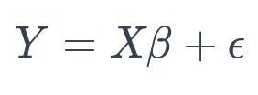
In matrix Notation
matrix
target values

Slide 44
challenges
Linearity Assumption
non-linear patterns
Multicollinearity
two or more independent variables in the model are highly correlated with each other
Overfitting and Underfitting
Outliers and Leverage Points
Linear regression is sensitive to outliers

Slide 45
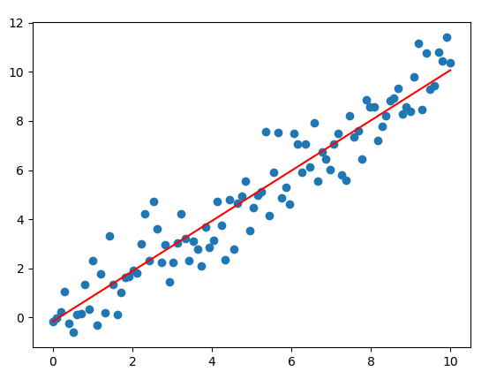
Error Function
The error function, also known as the loss or cost function, quantifies the difference between the predicted values from the model and the actual values in the dataset. It is a key component in supervised learning algorithms.

Slide 46
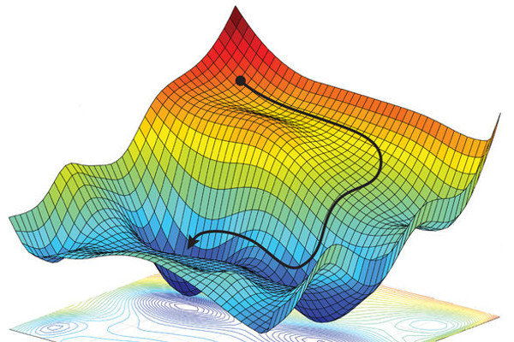
Gradient
In the context of machine learning, the gradient is a vector of partial derivatives. It points in the direction of the steepest increase of a function. In the case of the error function, the gradient points in the direction of the greatest increase in error.

Slide 47
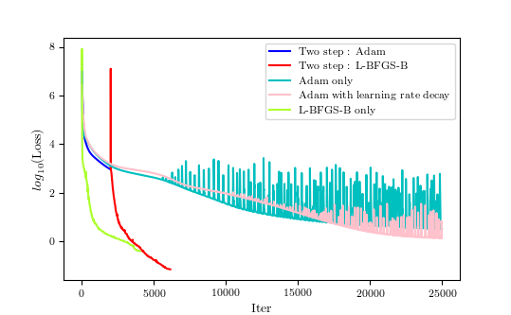
Convergence

Slide 48
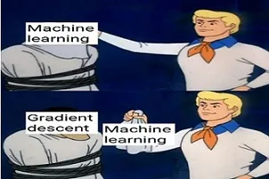
Types of gradients

Slide 49
Batch Gradient Descent

Slide 50
Error functions (Loss Functions) in Linear regression

Slide 51

Mean Squared Error (MSE)

Slide 52
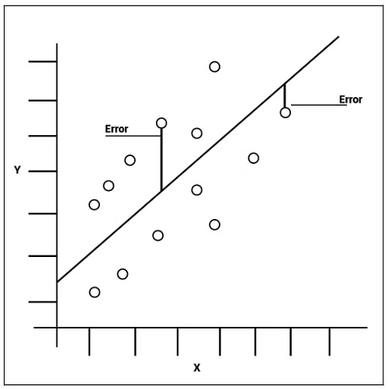
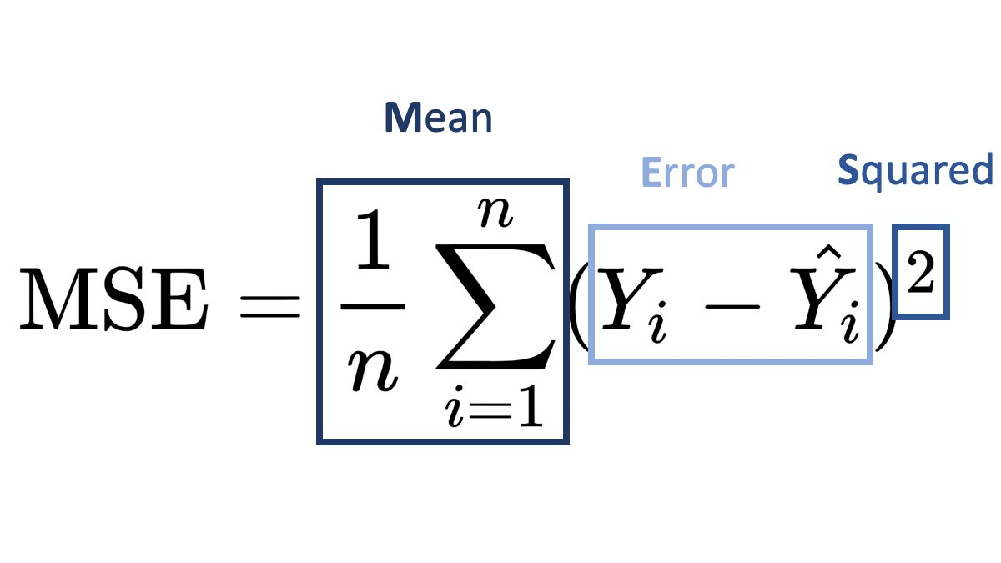

Slide 53
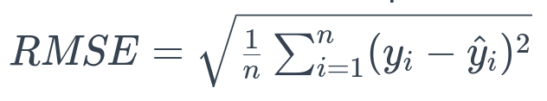
Root Mean Squared Error (RMSE)

Slide 54

Mean Absolute Error (MAE)
MAE is less sensitive to outliers compared to MSE and RMSE.

Slide 55
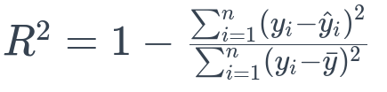
R-squared (Coefficient of Determination)
R-squared is a statistical measure of how close the data are to the fitted regression line. It's a proportion that indicates the percentage of the variance in the dependent variable that's predictable from the independent variables
Higher R-squared values indicate better fit

